Slide 1
Processing Workflows in Audio Archiving
DOBBIN CASE STUDIES:
Rob Poretti
Cube-Tec North America
Notes:
Welcome… and good morning… my name is Rob Poretti from Cube-Tec North America.
Cube-tec designs and builds archiving solutions ranging from “single box” ingest systems to complete audio preservation factories.
Cube-Tec was the first company to design products focused on the audio archiving markets with the development of QUADRIGA. They were involved in the development of the BWF format - in particular the Bext and Quality chunk. QUADRIGA was actually a co-development with the IRT and the German public broadcasters. It happened in parallel with the EBU specification of the BWF format in 1997.
So where QUADRIGA is our ingest engine - Dobbin is the logical extension of the preservation workflow. Once we start accumulating 1000’s of files, we need a way of managing them all… so this presentation will explore on how Dobbin accomplishes this task… with examples on how some of our users go about doing this…

Slide 2
Overview
Dobbin Case Studies:
What is Dobbin?
Software Suite Overview
QUADRIGA
Cube-Workflow
Dobbin
Case Studies from:
Library of Congress
The Media Preserve
National Archives
Libraries and Archives Canada
Notes:
So what exactly is Dobbin? We’ll explore that along with how Dobbin fits in our software suite.

Slide 3
Cube-Tec Archiving Tools
Dobbin Case Studies:
QUADRIGA
CUBE WORKFLOW
DOBBIN
Friendly purpose-built digitization GUI.
Import modules for popular legacy media formats.
Multiple stream ingest with integrated monitor.
Emphasis on audio quality and metadata.
Metadata driven workflow management & supervision software.
Import/Export XML metadata - web-service integration with Cube-Tec and 3rd party products.
Employs Business Process Model framework .
Scalable distributed batch processor.
Audio and metadata processing engine.
Simple graphical interface for creating workflow processes.
Powerful decision making.
Reporting
Notes:
So addressing these main components… [CLICK]
We start with QUADRIGA …A powerful purpose-built digitization interface.
Import modules for most legacy formats.
Multiple stream ingest with sophisticated monitoring functions for handling multiple sources, high-speed and reverse recording.
Finally - QUADRIGA has an emphasis on audio quality and metadata. [CLICK]
Ideally we want to drive our workflows with metadata derived from your data sources.
This requires Import/Export and integration with 3rd party products. [CLICK]
Finally we have Dobbin – which is a scaleable distributed batch processor.
It is both an audio and metadata processing engine and integrates a number of these functions with QUADRIGA.
It’s power is it’s simplicity and the ability to create complex workflows in a standardized and intuitive fashion. [CLICK] [CLICK]

Slide 4
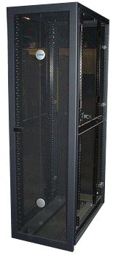
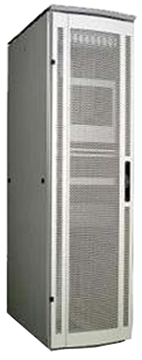
Integration
Dobbin Case Studies:
QUADRIGA
DOBBIN
AUDIOCUBE
Legacy
Database
CUBE WORK-FLOW
Asset
Management
System
Notes:
These tools can operate as standalone applications, but it can also be part of a suite that interact and communicate bi-directionally. [CLICK]
Metadata can be imported or exported directly to QUADRIGA or via Cube-Workflow… [CLICK]
This metadata can be created automatically, manually entered or imported/exported from external sources – as an input [CLICK] or as an output [CLICK]
[CLICK] to advance…

Slide 5
QUADRIGA
Dobbin Case Studies:
Notes:
So we’ll look more closely at the three tools that will create efficiencies from ingest to in-line access – the first of these is QUADRIGA.

Slide 6
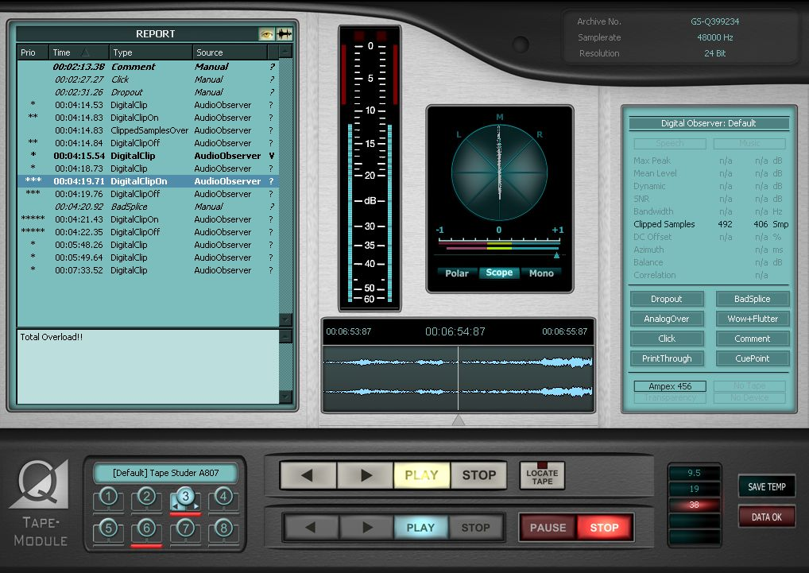
QUADRIGA
Dobbin Case Studies:
Efficient, purpose-built ingest system.
One workstation can provide up to eight parallel ingest streams simultaneously.
Audio stream supervision and complete quality analysis.
Sophisticated transport and monitoring systems built for various legacy formats
Integrated workflows with Cube-Workflows and Dobbin.
Notes:
With the QUADRIGA approach, we can have one workstation provide up to eight independent parallel ingest streams simultaneously. [CLICK]
The system costs offset redundant real-estate and equipment costs – we only require:
1 studio, 1 computer system, 1 audio monitoring system, etc. [CLICK]
Labor costs are dramatically decreased. [CLICK]

Slide 7
QUADRIGA: Hyper-Efficient Ingest
Dobbin Case Studies:
Multi-Machine Recording
Supports parallel ingest of up to eight streams simultaneously. Integrated monitoring and transport system for all eight devices regardless of type…
Multi-Speed Recording
Speeds from ½x to 4x with accurate playback equalization and pitch correction for proper real-time monitoring and automatic metadata for post-processing correction.
Multi-Channel Recording
Ingest mono, stereo or multi-channel sources up to 8 tracks with appropriate monitoring functions and analysis displays.
Dual-Direction
Ingest ½ track mono or ¼ track stereo open reel and compact cassette formats in one pass with real-time, reverse-corrected monitoring during capture.
Multi-format
Ingest up to 192 kHz/24 bit recordings and store as WAVE, RF64 or in the EBU standard BWF or MBWF formats. QUADRIGA can dynamically switch between formats on the fly.
Notes:
Multi-Machine Recording - Supports parallel ingest of up to eight streams simultaneously. Integrated monitoring and transport system for all eight devices regardless of type… . [CLICK]
Multi-Speed Recording - Speeds from ½x to 4x with accurate playback equalization and pitch correction for proper real-time monitoring and automatic metadata for post-processing correction. . [CLICK]
Multi-Channel Recording - Ingest mono, stereo or multi-channel sources up to 8 tracks with appropriate monitoring functions and analysis displays. . [CLICK]
Dual-Direction - Ingest ½ track mono or ¼ track stereo open reel and compact cassette formats in one pass with real-time, reverse-corrected monitoring during capture. . [CLICK]
Multi-format - Ingest up to 192 kHz/24 bit recordings and store as WAVE, RF64 or in the EBU standard BWF or MBWF formats. QUADRIGA can dynamically switch between formats on the fly. . [CLICK]

Slide 8
QUADRIGA: Hyper-Efficient Ingest
Dobbin Case Studies:
Observation
Automatic error detection and real-time audio analysis of errors originating in the analog and digital domain.
Integration
Employs standard interfaces like ODBC, SQL and XML via web-services, to connect to asset management or database systems as well as Cube-Workflow and Dobbin.
File Security
Guarantees audio file integrity and metadata integrity separately. Supports file based checksums like MD5 and SHA-1.
Automated Reports and Self Logging
BWF Coding History is automatically maintained throughout ingest and preservation lifecycles. Quality analysis reports are automatically generated at ingest.
Scalable
Provides a ”single-box” solution or can grow to a “preservation factory”, completely integrated with third party systems.
Notes:
Observation - Automatic error detection and real-time audio analysis of errors originating in the analog and digital domain. . [CLICK]
Integration - Employs standard interfaces like ODBC, SQL and XML via web-services, to connect to asset management or database systems as well as Cube-Workflow and Dobbin. . [CLICK]
File Security - Guarantees audio file integrity and metadata integrity separately. Supports file based checksums like MD5 and SHA-1. . [CLICK]
Automated Reports and Self Logging - BWF Coding History is automatically maintained throughout ingest and preservation lifecycles. Quality analysis reports are automatically generated at ingest. . [CLICK]
Scalable - Provides a ”single-box” solution or can grow to a “preservation factory”, completely integrated with third party systems. . [CLICK]

Slide 9
System Connection
Dobbin Case Studies:
QUADRIGA
USB
RS-232
RS-422
Notes:
A QUADRIGA system is normally installed on a DELL Workstation [CLICK]
The PC communicates with external transcription devices via a USB based QUADRIGA Machine Control. [CLICK]
QUADRIGA Machine Control – in turn – connects through various protocols and connections to various devices… [CLICK]
[CLICK] to advance…

Slide 10
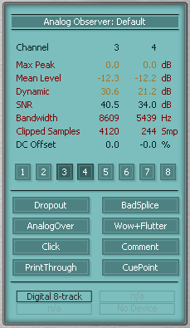
Automated Quality Analysis
Dobbin Case Studies:
AudioFile Inspector and Digital Error Checker are real-time analysis tools that automatically detect both analog and digital domain events in the audio stream.
Time domain events are time-stamped and displayed in a Report List. Events can be used as location markers in the recorded file.
Statistical analysis such as averages, means, ratios, etc. are displayed in real-time. Critical thresholds can be set for each event typed.
The complete analysis reports can be stored in the Quality Chunk of the BWF header and exported as XML based metadata.
Multiple analysis profiles can be created for any media type.
Notes:
Built into QUADRIGA is the possibility of real-time analysis tools that automatically detect both analog and digital events in the audio stream. [CLICK]
These events are time-stamped and displayed in a Report List. Events can be used as location markers in the recorded file. [CLICK]
Statistical analysis such as averages, means, ratios, etc. are displayed in real-time. Critical thresholds can be set for each event typed. That’s the image you see now. [CLICK]
The complete analysis reports can be stored in the Quality Chunk of the BWF header and exported as XML based metadata. [CLICK]
Multiple analysis profiles can be created for any media type. [CLICK]

Slide 11
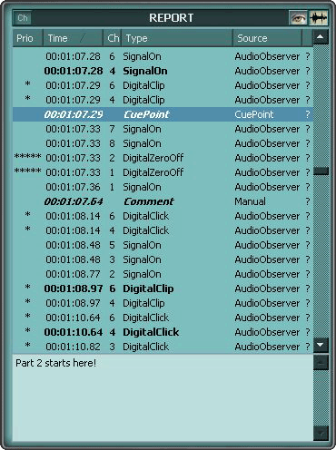
Automated Quality Analysis
Dobbin Case Studies:
Automatically Detected Events:
Start/End of Modulation, Signal Pauses
Analog Distortion, Clicks, Dropouts, Hum
Stereo/Mono, Speech/Music Content
S/N Ratio, Bandwidth, DC-Offset
Dynamic, Peaks, Average Level
Stereo Balance, Correlation, Azimuth Errors
Digital Zero, Digital Clicks, Digital Clipping, Block Repetition, Sample-Holds
Notes:
Here is what a Report List looks like… the automatically detected events are: [CLICK]
Start / End of Modulation, Pauses [CLICK]
Analog Distortion, Clicks, Dropouts, Hum [CLICK]
Stereo/Mono, Speech or Music Content [CLICK]
S/N Ratio, Bandwidth, DC-Offset [CLICK]
Dynamic, Peaks, Average Level [CLICK]
Stereo Balance, Correlation, Azimuth Errors [CLICK]
Digital Zero, Digital Clicks, Digital Clipping, Block Repetition, Sample-Holds [CLICK]

Slide 12
Cube Workflow
Dobbin Case Studies:
CUBE WORKFLOW
Notes:
Cube-Workflow is a flexible management solution that supports archiving teams in organizing their daily tasks.
It facilitates integration of Cube-Tec’s software with third party database or content management systems.
It allows metadata to flow from your own systems to drive work processes in Cube-Tec products without duplication of data entry and while supervising archiving activities. [CLICK]

Slide 13
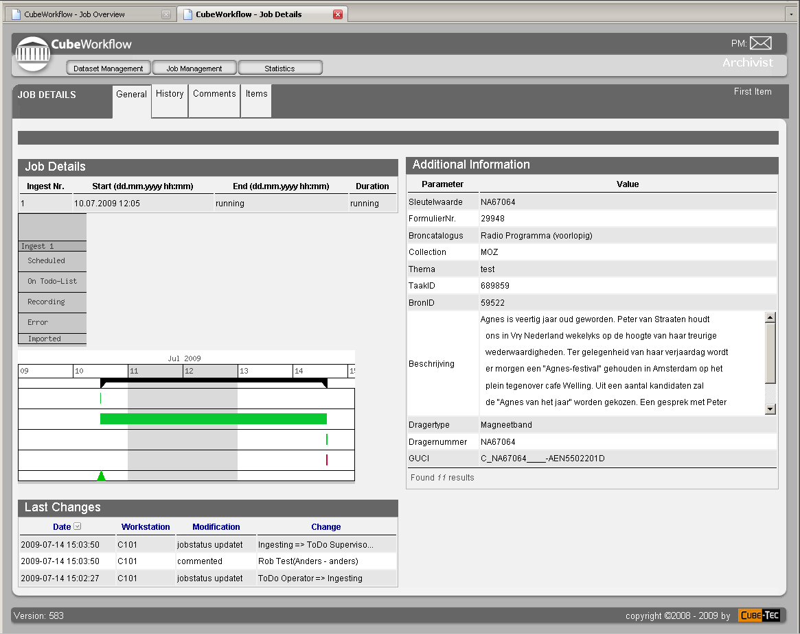
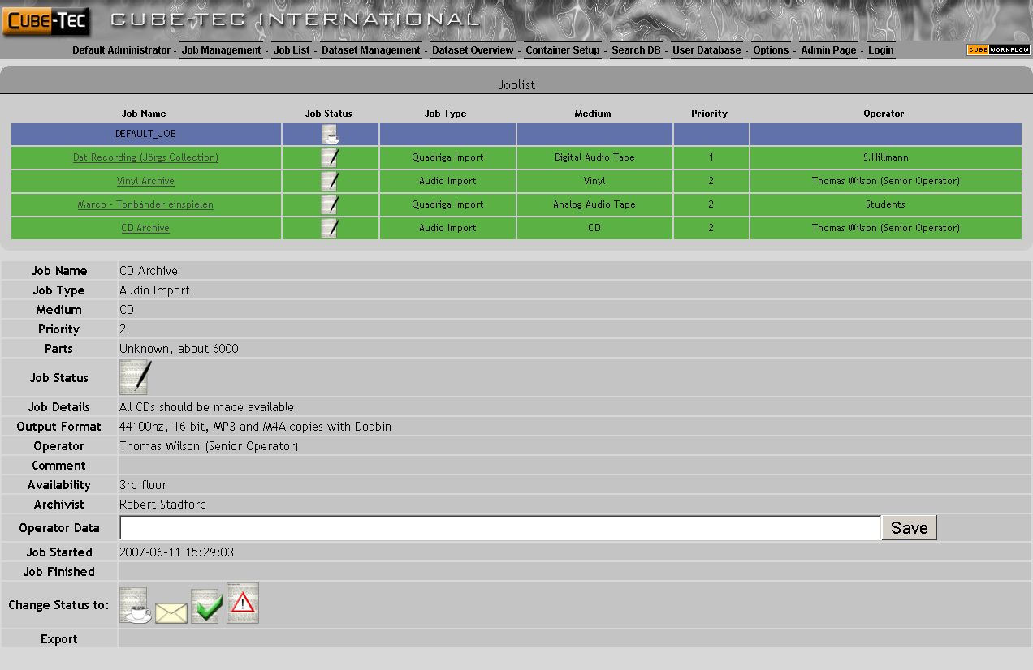
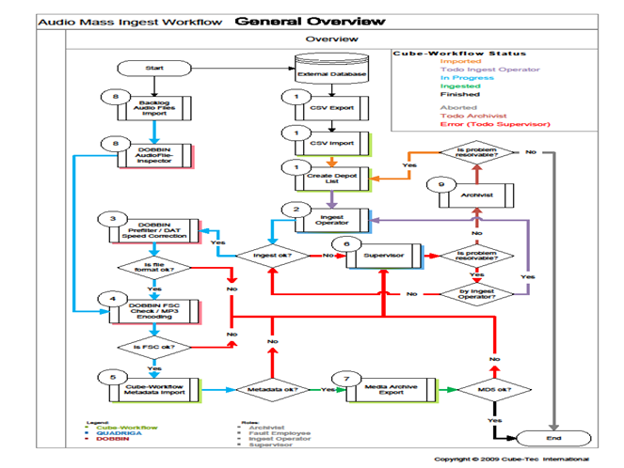
Cube Workflow
Dobbin Case Studies:
Systems Integration:
Cube Workflow connects to your DBMS or Asset Management System.
Underlying engine defined by Business Process Modeling.
User interface uses internet client – easily customizable and updateable. Simplifies deployment and accessible on the WWW.
Notes:
Cube-Workflow can be used as a connecting link between your existing Asset Management system and Cube-Tec archiving software. It can also be used as a stand-alone system.[CLICK]
Cube-Workflow’s underlying structure uses Business Process Modeling be used as a connecting link between your existing Asset Management system and Cube-Tec archiving software. It can also be used as a stand-alone system.[CLICK]
User interface uses internet client – easily customizable and updateable. Simplifies deployment and accessible on the world wide web. [CLICK]
Stop duplicating entry! You can use your existing metadata effectively - and throughout your complete preservation-chain life-cycle. [CLICK]
Cube-Workflow’s can be dynamic - adapting to collected metadata. [CLICK]
Exchanging process service information with other Cube-Tec products enable automatic processing between software applications. [CLICK]

Slide 14
Cube Workflow
Dobbin Case Studies:
Driven By Metadata:
Cube Workflow manages the task of automatically generating work-order processes for QUADRIGA and Dobbin systems.
Exchanges process service information with Dobbin and QUADRIGA.
Process chains do not have to be static.
Collected metadata can be exported back to DBMS.
Notes:
Cube-Workflow will generate work-order processes for QUADRIGA and Dobbin systems. For example, this means that an ingest can be started without any manual entry - all descriptive metadata will imported automatically through the ingest document. [CLICK]
Process service information is exchanged with Dobbin and QUADRIGA systems. This allows for completely automatic processes chains between different software. For example: an ingest file is created for QUADRIGA , where object and descriptive metadata is derived from an asset management system. A sub-set of that metadata is exported to a Dobbin folder to write ID3 tags for mp3’s and that will be created during a subsequent workflow generating derivatives. [CLICK]
Collected metadata can be used to dynamically adapt workflows. [CLICK]
Collected metadata – for example Coding History collected in QUADRIGA or quality analysis collected in Dobbin - is imported into Cube-Workflow and can be exported back to your asset management system. [CLICK]
It can operate as a stand-alone system with it’s own database engine, or as the connective link to your asset management system or database. [CLICK]

Slide 15
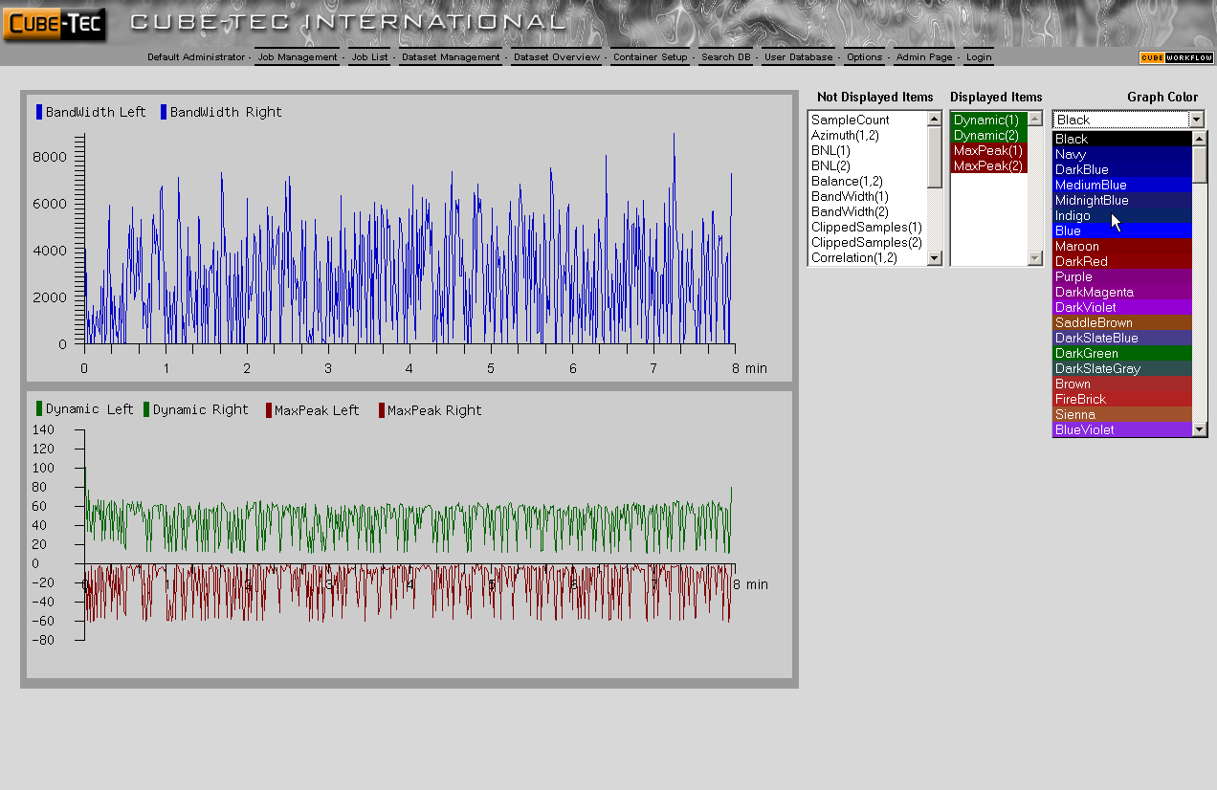
Cube Workflow
Dobbin Case Studies:
Manage your Workflows:
Supervises scheduled jobs and traces production issues using bi-directional messaging.
Email and SNMP notifications are event triggered from workflow processes.
Time-line based statistical information collected by QUADRIGA and Dobbin can be viewed in Cube-Workflow.
Notes:
Workflow supervises scheduled jobs and traces production issues using bi-directional messaging. [CLICK]
Email and SNMP notifications are event triggered from workflow processes. [CLICK]
Time-line based statistical information collected by QUADRIGA and Dobbin can be viewed in Cube-Workflow. [CLICK]

Slide 16
DOBBIN
Dobbin Case Studies:
Notes:
Dobbin is a master of file and metadata automation. It is a suite of products that allow for the creation of adaptive automated processes, delegates those processes to a distributed processing engine and generates metadata rich reports with live links to media assets.

Slide 17
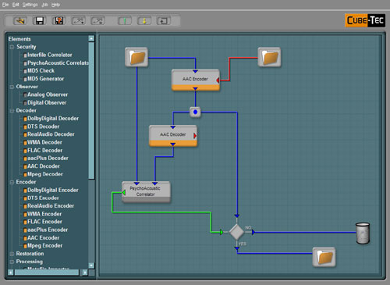
Create Powerful Workflows Simply
Dobbin Case Studies:
The Job Designer
Drag and drop your workflows. Connect processes using virtual audio, logic or metadata wiring.
Performs syntactic wiring check. Test newly created jobs with a single file.
Trigger jobs from file creation, file movement, metadata criteria, statistical analysis, external applications or manually.
Notes:
Dobbin allows you to design your job workflows by using a simple drag and drop interface. Processes are connected using “virtual” audio, logic or metadata wiring. [CLICK]
Dobbin performs a complete syntax integrity check. Before running a batch, you can test newly created jobs using a single file. [CLICK]
Jobs can be triggered from a file creation, from file movement, via metadata criteria, from statistical analysis, external applications or manually. [CLICK]

Slide 18
Automate Anything…
Dobbin Case Studies:
Content Analysis
Automatic quality analysis. Analog and Digital errors. Complete logging.
Processing
Comprehensive re-mastering and re-formatting tools. Automatic restoration tools.
File Conversion
Convert any PCM format. DDP translation. Integrate metadata.
File Security
FSC , MD5, SHA-1 and DDP integrity tools. File based and Psycho-acoustic correlators.
Audio File Encoding
Derivative generation for mp2/3, AAC, mpeg, DTS, AC3, WMA, MLP & more.
Tools
Complete logic tools for automated decisions. Integrates 3rd party applications and scripts.
Notes:
There are over 40 process elements available…
Content Analysis:
Dobbin provides complete automatic quality analysis for both analog and digital errors. You can drive workflows based on analysis results.
Digital Error Checker can identify: Digital Zeros, Block Repeating, Digital Clicks, Sample Holds, Digital Clips
Audio File Inspector can indentify: Analog Clicks, Hum, Analog Overs, Drop-outs, Non-Audio, Mono/Stereo, Bandwidth…
[CLICK]
Processing
Sophisticated re-mastering and re-formatting tools as well as state-of-the-art automated restoration tools are available.
Processing includes: Re-Sampling, Bit-resolution, re-formatting with Dither, File Reversing, Peak Normalization, Loudness Analysis and Loudness Management Tools
[CLICK]
File Conversion
Convert any PCM format at any bit-depth and sample rate. Translate DDP image sets. Tools to integrate metadata through workflows are available. Examples are: PCM File Converter, Multi-channel Down-mixing, DDP Conversion, Metadata Merging, Un-Seal
[CLICK]
File Security: FSC , MD5, SHA-1, and DDP integrity tools. File correlation at the sample level or using CODEC psycho-acoustic models.
Includes: MD5 Generator / Checker, SHA-1, FSC Checker, and my favorite – the Psycho-Acoustic Correlator
Audio File Encoding
A wide range of CODECs for creating derivatives and transcoding them to any format. MPEG Layer 2 / 3, AAC/ aac Plus, WMA / WMA 9 Pro, FLAC, MLP, Dolby Digital, and DTS
[CLICK]
Tools
A complete set of logic tools for automated conditional branching driven by metadata or quality analysis. Integrates 3rd party applications and scripts. Includes Decider, Start / End Folders, Nodes, Switch, and the Rule Editor
[CLICK]

Slide 19
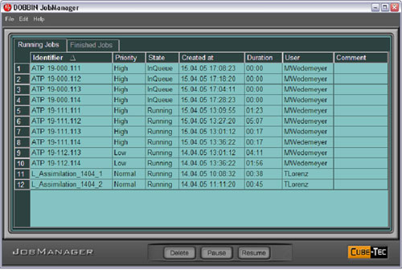
Supervise Multiple Concurrent Jobs
Dobbin Case Studies:
The Job Manager:
Real- time status of each job progress.
Re-prioritize job queue on-the-fly. Accurate job-time estimates.
Sorting and filtering of job list by any criteria.
Complete logging of all workflow processes.
Messaging service to Cube-Workflow for on-line updates
Notes:
The Dobbin Job Manager facilitates real-time monitoring of each job progress. [CLICK]
It allows you to re-prioritize the job queue on-the-fly. and includes provides accurate job estimates [CLICK]
Jobs can be sorted or filtered by any criteria. [CLICK]
Job Manager logs and timestamps all workflow processes. [CLICK]
Cube-Workflow users benefit from a bi-directional messaging system for complete on-line updates. [CLICK]

Slide 20
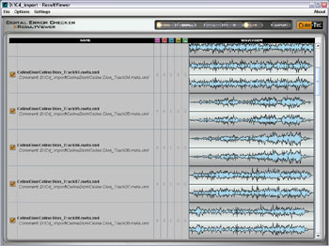
Automated Drill-Down Reporting
Dobbin Case Studies:
The Result Manager:
Complete reporting with drill-down capability and integrated waveform displays.
Sorting and intelligent filtering of all events. Events displayed on graphical timeline along with audio image.
Uses web technologies – available at any connected PC. Exchanging process service information with other Cube-Tec products.
Notes:
Complete reporting with drill-down capability and integrated waveform displays. [CLICK]
Sorting and intelligent filtering of all events. Events displayed on graphical timeline along with audio image. [CLICK]
Uses web technologies – available at any connected PC. Exchanging process service information with other Cube-Tec products. [CLICK]

Slide 21
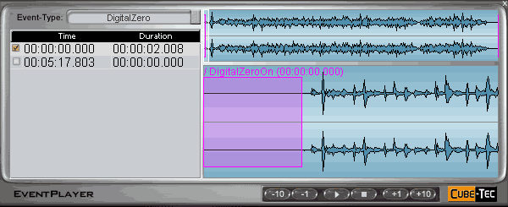
Play & View Your Results
Dobbin Case Studies:
The Event Player:
Launch the BWF player from your web-page with integrated event list and waveform graphical display.
Built in sample rate converter provides audio playback on any computer sound card.
List can re-populate with any event-type and each item can be used to locate with pre-roll.
Notes:
Launch the BWF player from your web-page with integrated event list and waveform graphical display. [CLICK]
Built in sample rate converter to audio playback on any computers sound card. [CLICK]
The event list area can re-populate with any event-type and each item can be used to locate with pre-roll. [CLICK]

Slide 22
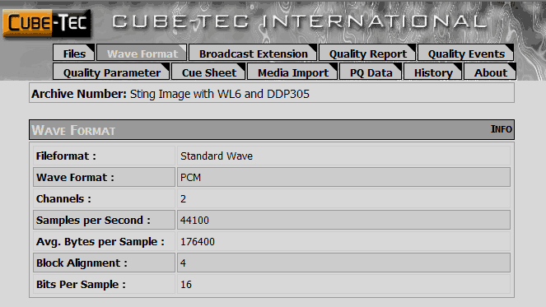
Transform Your Data
Dobbin Case Studies:
Print your Results:
XML reports are styled using XSLT. Templates are provided for viewing and printing.
Easily customizable by any web developer. This can include connections to external data sources.
Can be stored as intranet resource for archive group stakeholders.
Notes:
XML reports are styled using XSLT. Templates are provided for viewing and printing. [CLICK]
Easily customizable by any web developer. This can include connections to external data sources. [CLICK]
Can be stored as intranet resource for archive group stakeholders. [CLICK]

Slide 23
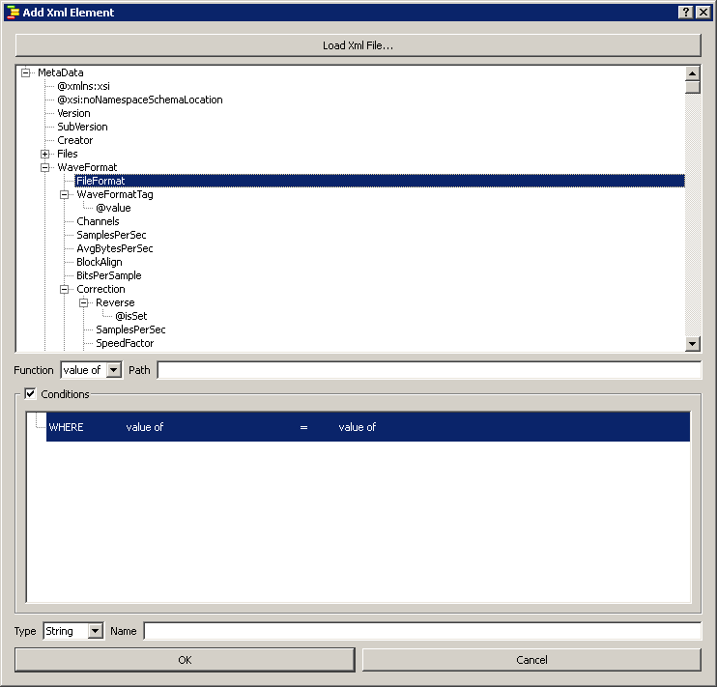
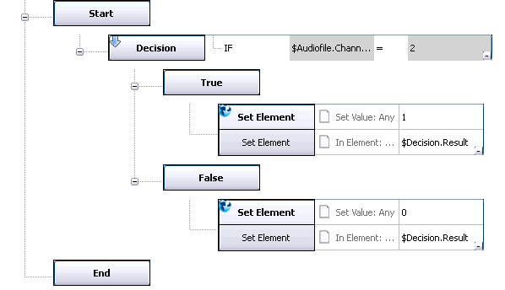
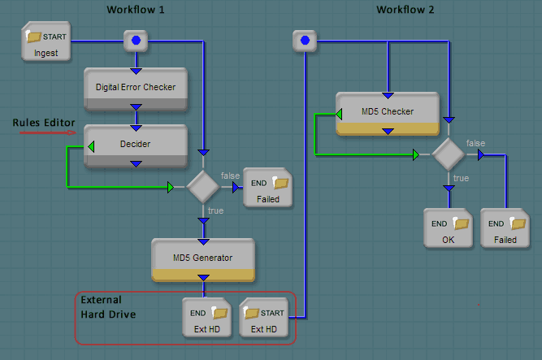
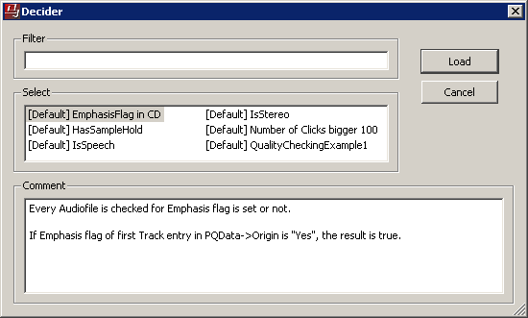
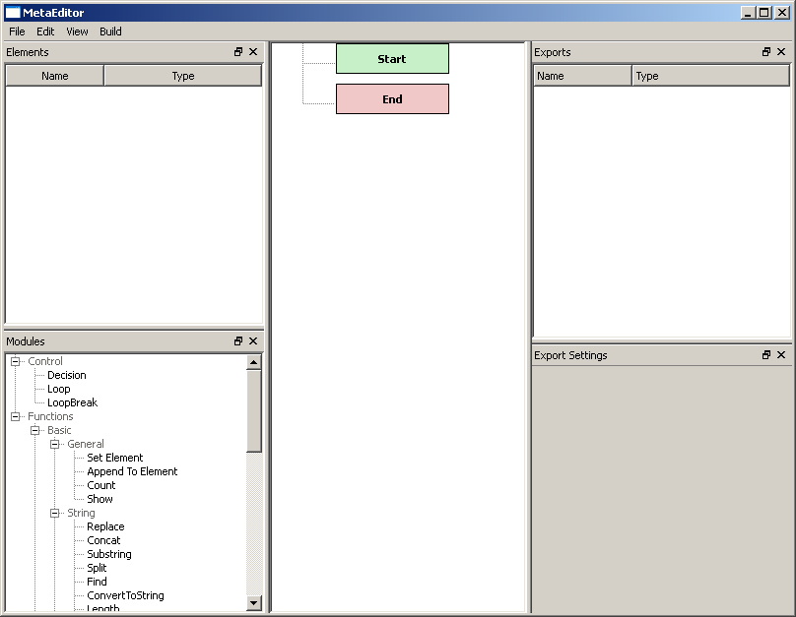
The Rule Editor
Dobbin Case Studies:
A Dobbin utility for creating rules used by modules performing workflow decisions
Completely integrates meta-data schema from the BWF format and the complete Cube-Tec software suite – Dobbin, QUADRIGA, and Cube-Workflow.
Drag-and-Drop interface facilitates simple rule creation and minimizes human-error.
Rules are loaded and stored into a module from Job Designer – example: the Decider module.
Rules become the intelligence that drives dynamic workflows.
Notes:
The final software component of Dobbin is the Rule Editor. [CLICK]
The Rule Editor is a utility for creating rules used by modules that perform workflow decisions – Example: Decider. [CLICK]
These rules are loaded and stored into a module from Job Designer. [CLICK]
The Rule Editor interface is called the Workbench. Here, you traverse the various schemas and use simple drag-and-drop techniques to define the elements and rule logic. [CLICK]

Slide 24
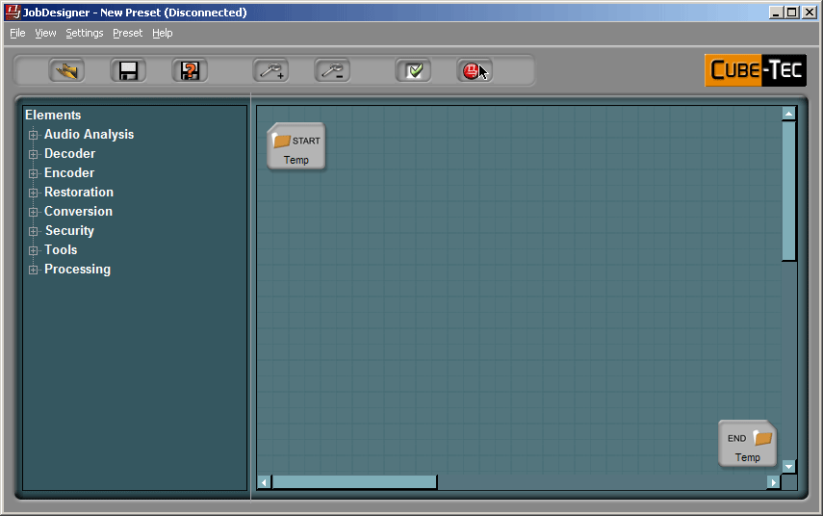
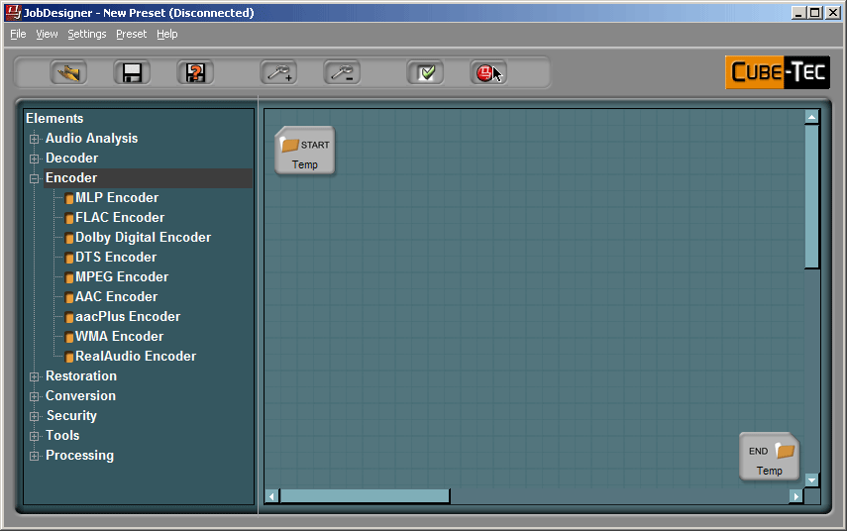
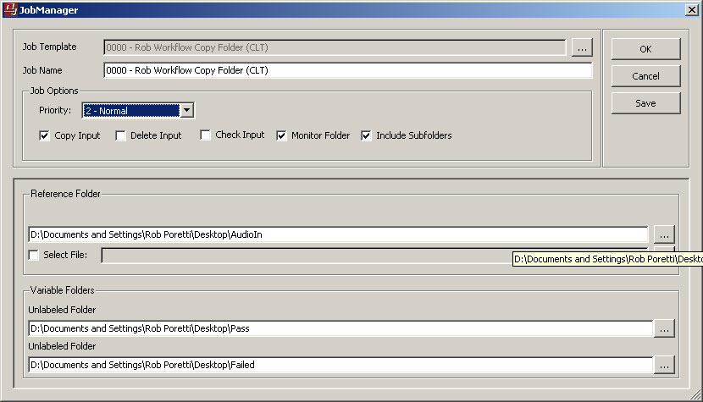
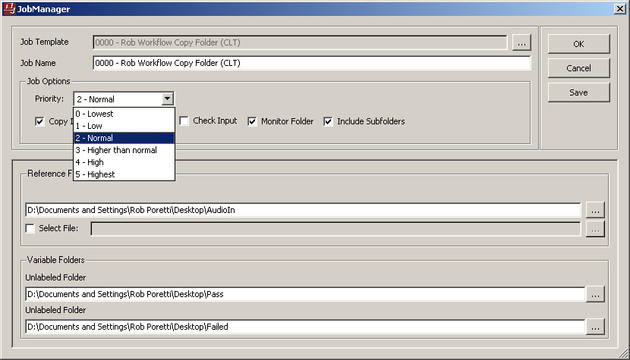
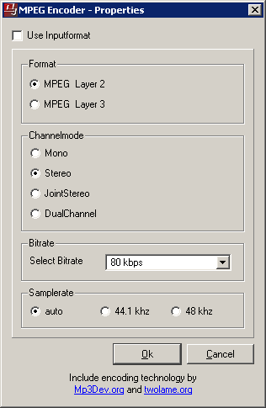
Dobbin Case Studies:
Notes:
Basic Demo…
The work area is similar to a flow chart application like VISIO. Workflows using audio files or metadata, start and end in folders. [CLICK]
Elements are dragged from the left hand side to the grid./work-area. In this case we are going to encode some BWF files as mp3’s. [CLICK]
The IN folder is where the BWF files reside. The folder OUT pin is connected to the ENCODER IN pin. [CLICK]
Then the OUT pin of the ENCODER is connected to the IN pin of the END folder. [CLICK]
Once the connections are made, then we set properties of each element. For example, the paths of the folder element are set - and here we see the possibilities with the mp3 encoder. [CLICK]
Once the properties are set, we can test the workflow with a logic test and either run the job or create a template for future or similar jobs. This is performed through the Job Manager window. [CLICK]
When processing many jobs, it’s important to be able to set the job priority . . [CLICK]
It’s also possible to have jobs run automatically based on monitoring the INPUT folder. For example, when new BWF files are moved into the INPUT folder, the defined job of creating mp3 derivatives will run automatically.
When you’re ready - press OK and the JOB runs. [CLICK]

Slide 25
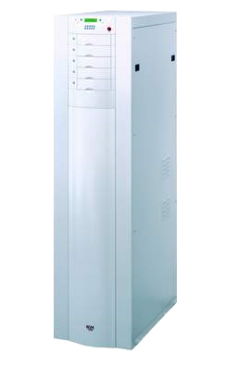
Managing Multiple Ingest Streams
Dobbin Case Studies:
PYRAMIX
WAVELAB
NUENDO
SONIC
PROTOOLS
CD-DVD ROM
FTP/Internet
…whatever!
QUADRIGA
CD INSPECTOR
QUADRIGA
Notes:
We’re going to consider a workflow where we combine all the efficiencies we discussed and take material from multiple parallel ingest streams, create a preservation master move it to a repository, create derivatives for both intranet and internet access and perform quality and integrity tests throughout. [CLICK]
In this workflow, we’re going to simplify some processes and have a single START folder. It’s often advantageous to create multiple START folders that are optimized for specific ingest streams – we’ll forgo that for brevity. [CLICK]
Our first set of streams is from a 4 machine QUADRIGA system using Tascam cassettes. [CLICK]
Our seconds set of files are dervided from the Cube-Tec CD Inspector – a specialized version of QUADRIGA, specifically for capturing from CD’s using large CD jukeboxes. [CLICK]
Next is a two machine QUADRIGA system - this time, with two Studer open-reel decks. [CLICK]
Finally, files can come from any digital source – other workstations or other media types… [CLICK]

Slide 26
Creating a Preservation Master & Derivatives
Dobbin Case Studies:
Preservation
Master
Intranet
Browsing
Internet
Browsing
Telephony
Access
Rule Editor
24/96 BWF
16/44.1 WAVE
mp3
G.xxx
Notes:
The ingest folder is fed into the audio file inspector that performs quality analysis. Its output pin goes to the Decider which uses criteria defined by the Rule Editor [CLICK]
The Rule Editor is defines the criteria that is used to make the decision: is this recording of reasonable quality?
Perhaps all files should pass this evaluation. Different facilities will have different requirements. In this particular case, [CLICK]
if the file passes, we will create a preservation master and a number of derivatives:
The Preservation Master at 24/96 [CLICK]
A CD quality wave file for intranet access. [CLICK]
A VBR mp3 complete with ID3 tags. [CLICK]
And a low bit-rate telephony file… [CLICK]
Each END folder for these file versions reside on different network storage resources. Our preservation Master goes to our trusted digital repository.
[CLICK]

Slide 27
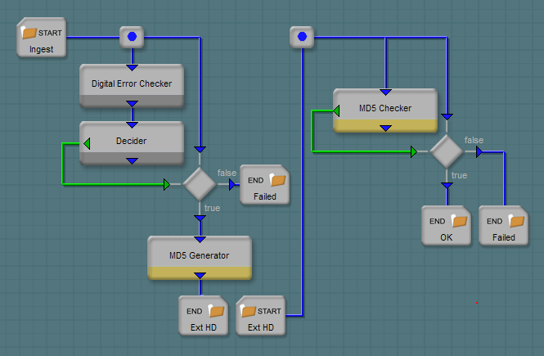
Example: File Security – The Rule Editor
Dobbin Case Studies:
Rule
Editor
Notes:
A more advanced example…
In this example we will be checking the source audio quality using the Digital Error Checker. An example of this might be to make sure files moved over a net work or even via ftp do not have clicks or other erros associated with file electronic transmission.
The output of the Digital Error Checker output goes to a logic tool called Decider. Decider can use the Digital Error Checker analysis to branch to different processing flows. [CLICK]
The Rule Editor is a metadata editor application that defines the criteria used in this analysis. The green logic pin of the decider is connected to a switch. If the analysis result is false, the workflow fails and terminates in an END folder. [CLICK]
If the analysis is true the workflow continues to and MD% Generator and the file is moved to the END folder. This folder path might be in a remote repository. [CLICK]
There is an additional workflow on this grid that that use

Slide 28
Dobbin Case Studies:
CASE STUDIES
Notes:
I’ll now review some case studies of how Dobbin solves workflow issues using Dobbin automation.

Slide 29
Library of Congress – File Security Code on Parallel Streams
Case Study #1:
QUADRIGA Cassette Ingest - 4 parallel streams
Ingests approximately 1 TB per day.
Dobbin seals BWF’s as a low-priority, background process:
Moves pre and post modulation material to private chunks.
Creates separate FSC (MD5) for audio data and metadata.
Moves material from pre-sealed (folder) location to “Sealed BWF” folder.
IT department systems pulls sealed BWF’s to repository every evening.
Notes:
QUADRIGA Cassette Ingest - 4 parallel streams
Ingests approximately 1 TB per day.
Dobbin seals BWF’s as a low-priority, background process:
Moves pre and post modulation material to private chunks
Creates separate FSC (MD5) for audio data and metadata
Moves material from pre-sealed (folder) location to “Sealed BWF” folder
IT department systems pulls sealed BWF’s to repository every evening.

Slide 30
Library of Congress – File Security Code on Parallel Streams
Case Study #1:
FSC Seals BWFs: Private chunks are created, checksums are created and embedded into BWF.
Pre-Sealed BWF’s: QUADRIGA moves temporary recordings to “pre-sealed” folder when operator selects data “OK”.
QUADRIGA
Sealed Files Moved: Sealed BWF’s are moved to folder in preparation for migration to repository.
Dobbin Watch Folder: When new files are created in a watch folder, the FSC workflow is initiated.
Notes:
Pre-Sealed BWF’s: QUADRIGA moves temporary recordings to “pre-sealed” folder when operator selects data “OK”.
Dobbin Watch Folder: When new files are created in a watch folder, the FSC workflow is initiated.
FSC Seals BWFs: Private chunks are created, checksums are created and embedded into BWF.
Sealed Files Moved: Sealed BWF’s are moved to folder in preparation for migration to repository. LC’s IT applications does this work.

Slide 31
The Media Preserve – Derivatives & File Security
Case Study #2:
Workflow 1: Quality Analysis and Create MD5 Checksums
Create QA Reports for each ingested file.
Create MD5 for file copies.
Workflow 2: Creating Derivatives
Derive two derivatives from preservation master
CD formatted files 16/44.1
mp3
Workflow 3: Noise Reduction/Automatic Restoration Workflow
Gentle restoration
Notes:
Workflow 1: Quality Analysis and Create MD5 Checksums
Create QA Reports for each ingested file.
Create MD5 for file copies.
Workflow 2: Creating Derivatives
Derive two derivatives from preservation master
CD formatted files 16/44.1
mp3
Workflow 3: Noise Reduction/Automatic Restoration Workflow
Gentle restoration

Slide 32
The Media Preserve – Derivatives & File Security
Case Study #2:
Workflow 1 - QA and MD5 Generation
An Ingest folder is watched by Dobbin.
When new files are created, AudioFile-Inspector performs quality analysis.
An MD5 is created and the checksum, BWF and report files are moved to a storage server.
Notes:
Workflow 1 - QA and MD5 Generation
An Ingest folder is watched by Dobbin.
When new files are created, AudioFile-Inspector performs quality analysis.
An MD5 is created and the checksum, BWF and report files are moved to a storage server.

Slide 33
The Media Preserve – Derivatives & File Security
Case Study #2:
Workflow 2 – Automated Restoration
The Start folder represents files that requires restoration prior to creating derivatives.
When a file is created here, Dobbin trigger a workflow
Notes:
Workflow 2 – Automated Restoration
The Start folder represents files that requires restoration prior to creating derivatives.
When a file is created here, Dobbin trigger a workflow

Slide 34
The Media Preserve – Derivatives & File Security
Case Study #2:
Workflow 3 - Creating Multiple Derivatives
Start folder can represent any set of files that requires derivatives and can include any sub-set of folders.
Left Path – 24/96 Masters is re-sampled to 44.1 kHz and dithered down to 16-bit.
Right Path – mp3 creation.
Notes:
Workflow 3 - Creating Multiple Derivatives
Start folder can represent any set of files that requires derivatives and can include any sub-set of folders.
Left Path – 24/96 Masters is re-sampled to 44.1 kHz and dithered down to 16-bit.
Right Path – mp3 creation.

Slide 35
National Archives – Quality Control and Reference Creator
Case Study #3:
Quality Control for 3rd party digitization projects required.
Check Format : WAVE Format, Sample Rate, Bit Depth, Channel Count
Check Audio Quality: Digital Zeros, Block Repeating, Digital Clicks, Clipping, Noise Level, Peaks, etc.
Passed files enters normal production workflows.
Failed files are manually checked - 3rd party is contacted.
Access derivatives are created from Preservation Master
“Reference copies” created to NARA format standards:
16bit, 44.1 kHz, Stereo WAVE
Notes:
Quality Control for 3rd party digitization projects required.
Check Format : WAVE Format, Sample Rate, Bit Depth, Channel Count
Check Audio Quality: Digital Zeros, Block Repeating, Digital Clicks, Clipping, Noise Level, Peaks, etc.
Passed files enters normal production workflows.
Failed files are manually checked and then 3rd party is contacted.
Access derivatives are created from Preservation Master
“Reference copies” created to NARA format standards:
16bit, 44.1 kHz, Stereo WAVE

Slide 36
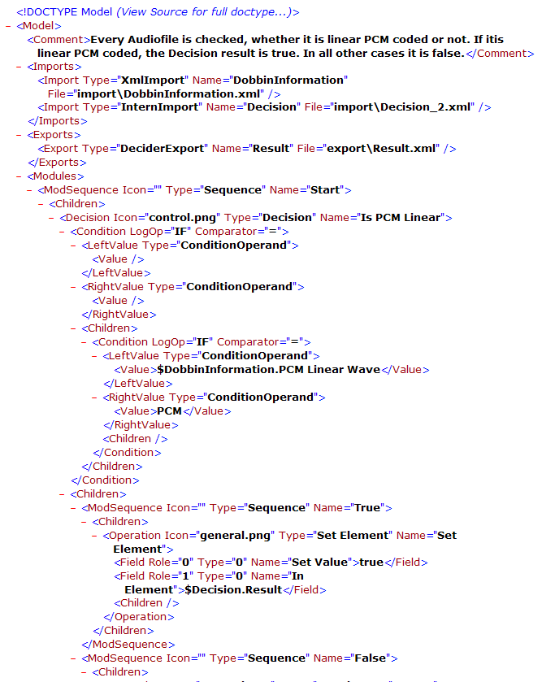
National Archives – Quality Control and Reference Creator
Case Study #3:
Create criteria for various checks:
WAVE Format
24 Bit
96 kHz
Mono
Each “rule” can be stored as a separate preset, used by the Decider module within Dobbin workflows.
DOBBIN
Rule Editor
Notes:
Create criteria for various checks:
WAVE Format
24 Bit
96 kHz
Mono
Each “rule” can be stored as a separate preset, used by the Decider module within Dobbin workflows.

Slide 37
National Archives – Quality Control and Reference Creator
Case Study #3:
Workflow Overview:
Part 1: Format Check
Wave?
24 bit?
96kHz?
Mono?
Part 2: Audio Quality Analysis & Loudness Analysis
Notes:
Workflow Overview:
Part 1: Format Check
Wave?
24 bit?
96kHz?
Mono?
Part 2: Audio Quality Analysis & Loudness Analysis

Slide 38
National Archives – Quality Analysis & “Reference” file
Case Study #3:
Job Designer Workflow:
Start folder connects to decider module.
Green logic pin is connected to switch.
Load rule into Decider to test for WAVE.
IsWAVE
WAVE?
Test Fails: media & report moved here:
Test Passes: Workflow continues…
Notes:
In this Workflow:
Start folder connects to decider module.
Green logic pin is connected to switch.
Check file for WAVE by loading Rule into Decider

Slide 39
National Archives – Quality Analysis & “Reference” file
Case Study #2:
Check file for 24 bit by loading Rule into downstream Decider
24 Bit?
Test Fails: Media & report moved here:
Test Passes: Workflow continues…
Notes:
Check file for 24 bit by loading Rule into downstream Decider

Slide 40
National Archives – Quality Analysis & “Reference” file
Case Study #2:
Check file for 96 kHz by loading Rule into downstream Decider
96kHz?
Test Fails: Media & report moved here:
Test Passes: Workflow continues…
Notes:
Check file for 96 kHz by loading Rule into downstream Decider

Slide 41
National Archives – Quality Analysis & “Reference” file
Case Study #2:
Check file for mono/stereo by loading Rule into downstream Decider
Mono?
Test Fails: Media & report moved here:
Test Passes: Workflow continues…
Notes:
Check file for mono/stereo by loading Rule into downstream Decider

Slide 42
National Archives – Quality Analysis & “Reference” file
Case Study #2:
Check Audio Quality Parameters
Check Loudness Report
Audio-File Inspector: Audio quality analysis performed here. Report created.
Loudness Report: Loudness analysis performed here. Report created.
Notes:
Check Audio Quality Parameters
Check Loudness Report

Slide 43
National Archives – Quality Analysis & “Reference” file
Case Study #3:
A watch folder stores 24/96 intermediate files from production workflows
Dobbin creates reference files prepared for CD-R creation – 16/44.1 kHz
Step 1: Peak normalize audio files to 0 dBFS
Step 2: Re-Sample of 96 to 44.1 kHz Fs
Step 3: Re-Dither when converting from 24 to 16 bit.
Notes:
(Purposely blank)

Slide 44
?
r.poretti@cube-tec.com
Thank-you!
Rob Poretti
Cube-Tec North America
Notes:
Thank-you... [CLICK]
Questions [CLICK]
Reach me at r.poretti@cube-tec.com [CLICK]

