Slide 1
Indiana University Bloomington
Media Preservation Initiative
Mike Casey
Director of Media Preservation Services
micasey@indiana.edu
Website: http://www.indiana.edu/~medpres/
Blog: http://mediapreservation.wordpress.com/

Slide 2
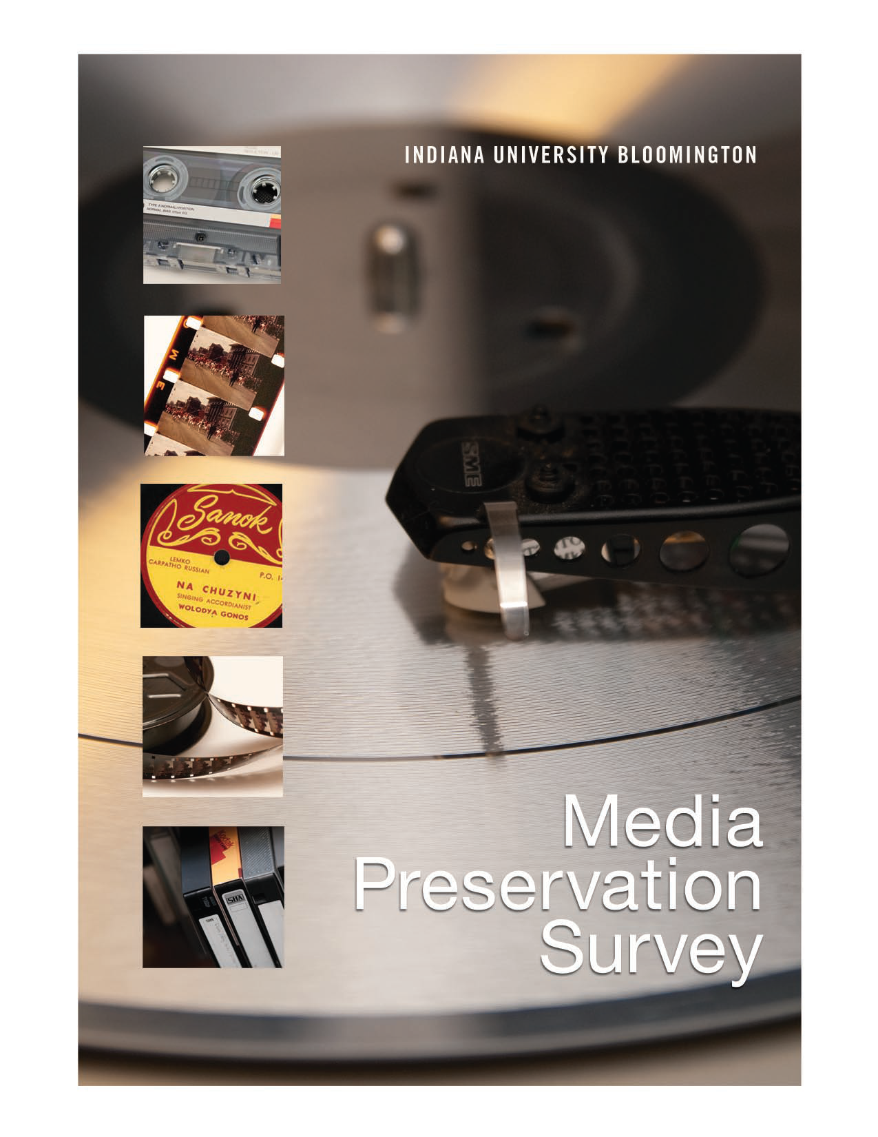

Slide 3
What is the problem?
Large numbers
Degradation
Obsolescence
High research value
Short time window

Slide 4
Survey Report
Audio, video and film on the Bloomington campus
Analysis of format degradation/obsolescence risks
Tabulation and analysis of campus holdings
Examples of high research value

Slide 5
Numbers
More than 560,000 audio, video, film objects
  364,000 audio (64%)
  125,000 video (22%)
  78,000 film (14%)
80 units
50+ formats

Slide 6
Numbers
44% Unique or Rare 56% Commercial
(248,000)

Slide 7
Degradation/Obsolescence
How much time do we have?
15-20 years
Less for some formats
Degradation + Obsolescence = Impossible/Too Expensive
If we start now…

Slide 8
Strategies
Audio and Video
How long will it take?
At our current pace…
Archives of Traditional Music: 58 years
Music Library: 120 years
Key Words: Massive, rapid, considered

Slide 9
Strategies
Planning Project
July 1, 2010—June 30, 2011
Funded by Provost, OVPR, UITS, Libraries, COAS
Creation of Media Preservation Task Force
Consultant—AudioVisual Preservation Solutions (AVPS)
Charge from Provost

Slide 10
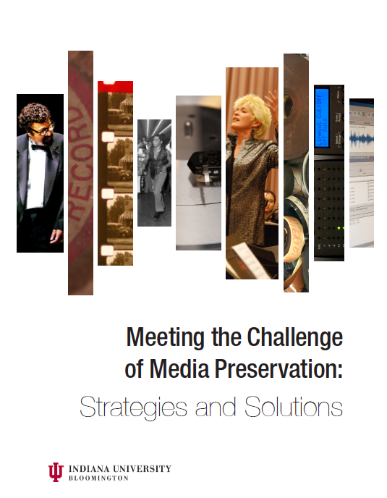

Slide 11
Indiana University Bloomington
Media Preservation Advisory Board
Media Preservation Task Force
Media Preservation
Working Group
Consultant:
AudioVisual Preservation Solutions (AVPS)
External
Advisory Board

Slide 12
Strategies
Preservation Principles
Long time horizon
Timeliness
Digitize once
Standards/best practices
Leverage existing resources
Partnerships
Curatorial/unit responsibility
Transparency
Prioritization
Efficiency
Accuracy and integrity
Preservation and access

Slide 13
Strategies
Access Principles
Description/cataloging
Copyright strategies
Rights management
Standards/best practices
Curatorial/unit responsibility
Automation
Derivative quality
Object/collection management

Slide 14
Strategies
Develop In-house or Outsource Analysis
Scale and uniformity
Quality control
Future location of expertise
Education
National leadership
Cost

Slide 15
Strategies
Approach to Preservation Transfer Analysis
Custom 1:1
Parallel transfer
  Mass migration
  Mass digitization
  Small-scale
Intersection of preservation principles and efficiency
Indiana approach

Slide 16
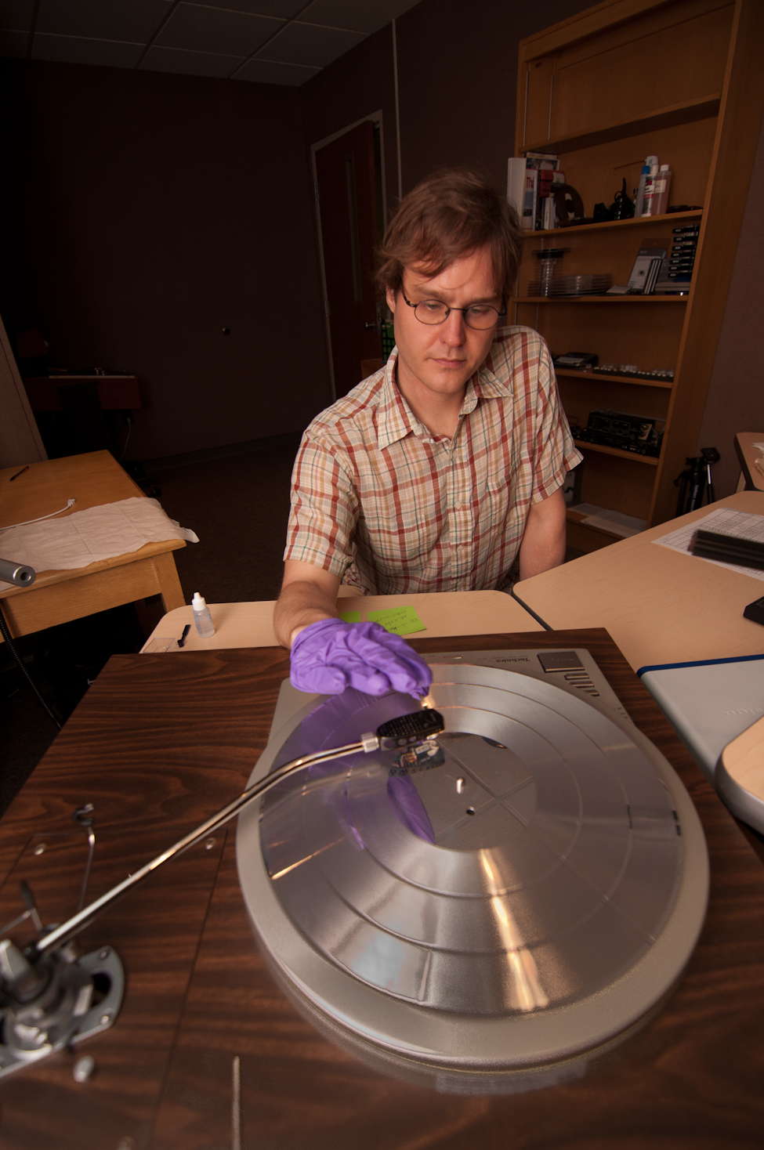

Slide 17
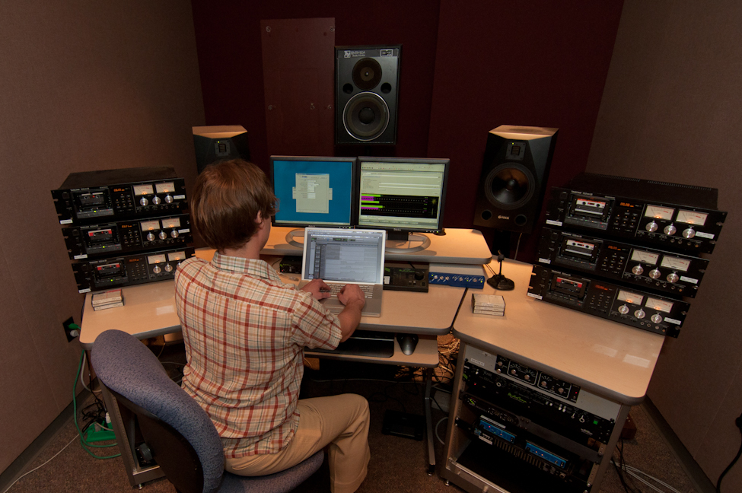

Slide 18
Strategies
Indiana Media Preservation and Access Center
(IMPAC)
Audio preservation transfer
Video preservation transfer
Film conservation and access digitizing

Slide 19
Strategies
Indiana Media Preservation and Access Center
(IMPAC)
Pre-digitization prep services for units
  ‘SMART’ team
Derivative creation
Quality control
Ingest into preservation repository
Access tools and infrastructure

Slide 20
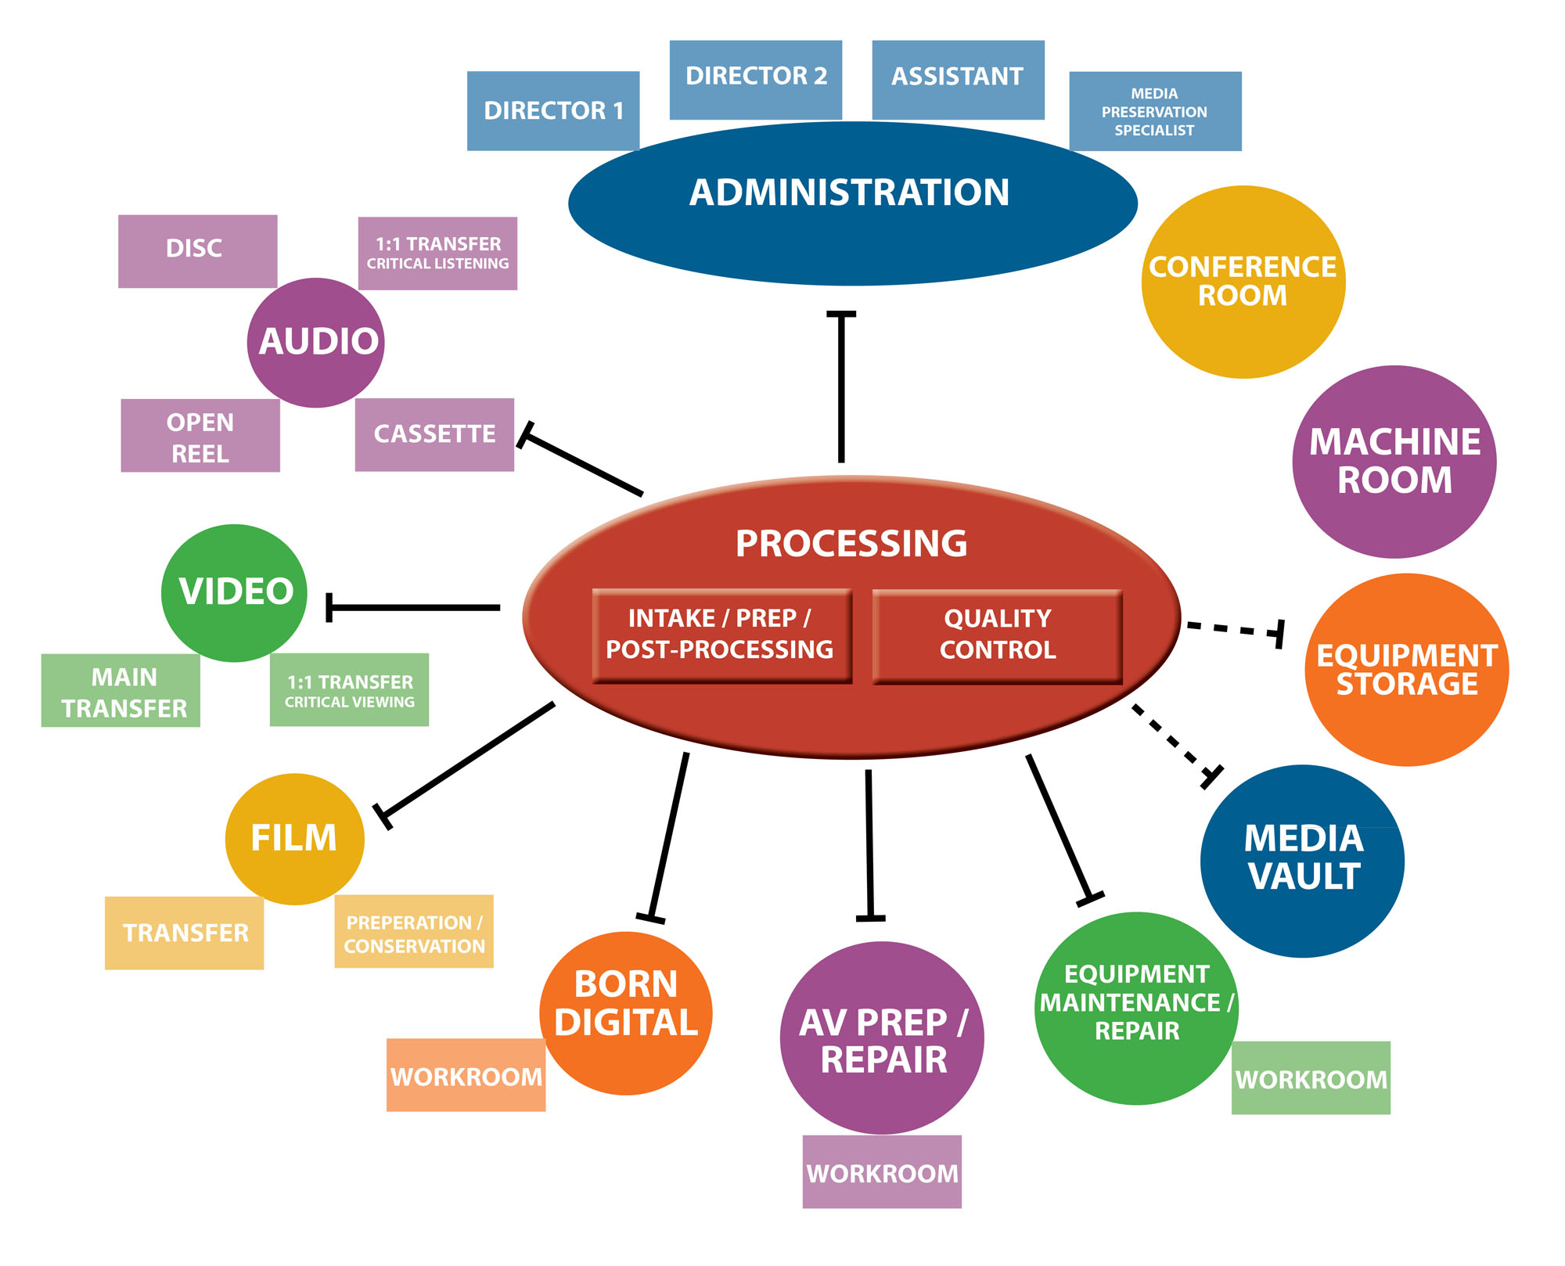

Slide 21
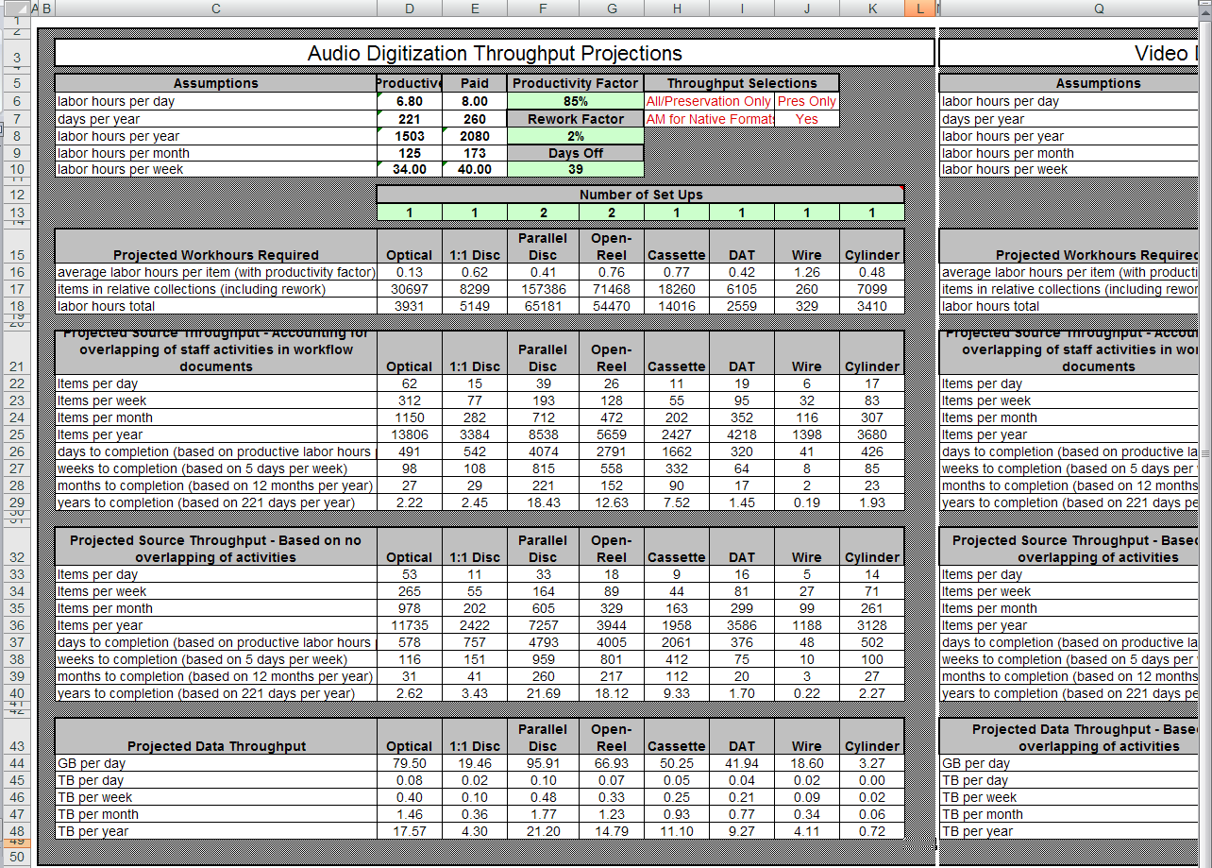

Slide 22
Strategies
Media Preservation Targets 2013-2027
15 year time frame
207,000 hours of audio (82% of total IUB holdings) = 284,000 recordings
83,000 hours of video (53% of total holdings) = 66,000 recordings
27,000 hours of film (69% of total holdings)

Slide 23
Strategies
Indiana Media Preservation and Access Center
How do we get it done in 15 years?
How do we attain massive, rapid and considered?
Assumptions behind the data

Slide 24
Strategies
Prioritize
Develop tools
Preservation condition/risk: MediaSCORE
Research/instructional value: MediaRIVERS
Curatorial/unit staff engagement
First 5 year priorities

Slide 25
Strategies
Automate
Parts of the workflow that machines can do faster and more accurately
Metadata embedding, metadata entry
Derivative creation
File copy to storage, ‘checksum’ creation and verification
In production for audio preservation (Sound Directions)

Slide 26
Strategies
Parallel Transfer Workflows
Simultaneous digitization of multiple sources where appropriate
Sound Directions practices for research archives
Adapt solutions from mass digitization of broadcast archives
With automation = huge increase in efficiency and productivity
Mix of 1:1, 2:1, 4:1

Slide 27
Strategies
Film
Control climate: storage in ALF
Access (and preservation?) digitization
Scanning technology changes and future
Establish film archive in IU Libraries
IU Cinema

Slide 28
Strategies
Video Preservation Pilot Projects
Collaboration with Radio and Television Services
Test SAMMA Solo and Digital Rapids systems
JPEG2k/MXF vs. Uncompressed/QT
8 bit vs. 10 bit
Quality control procedures
Visual analysis

Slide 29
2011-12 Priorities
Top Priorities
Explore public-private and public-public partnerships
Learn from Europe
Campus prioritization plan
Media access working group
  develop recommendations from principles
IMPAC start-up project
Communication strategy

Slide 30
Strategies
IMPAC Start-up Project
Begin work before physical location
Leverage existing infrastructure and expertise
Sound Directions staff

Slide 31
Strategies
IMPAC Start-up Project
Develop workflows
Test concepts
Gain further experience
Point to high-value preserved content
Preserve a few recordings

Slide 32
Strategies
IMPAC Start-up Project
Partners
Archives of Traditional Music
Cook Music Library and Jacobs School of Music
Radio and Television Services
IU Bloomington Libraries—Film Archivist
Content holders—Lilly Library and others

Slide 33
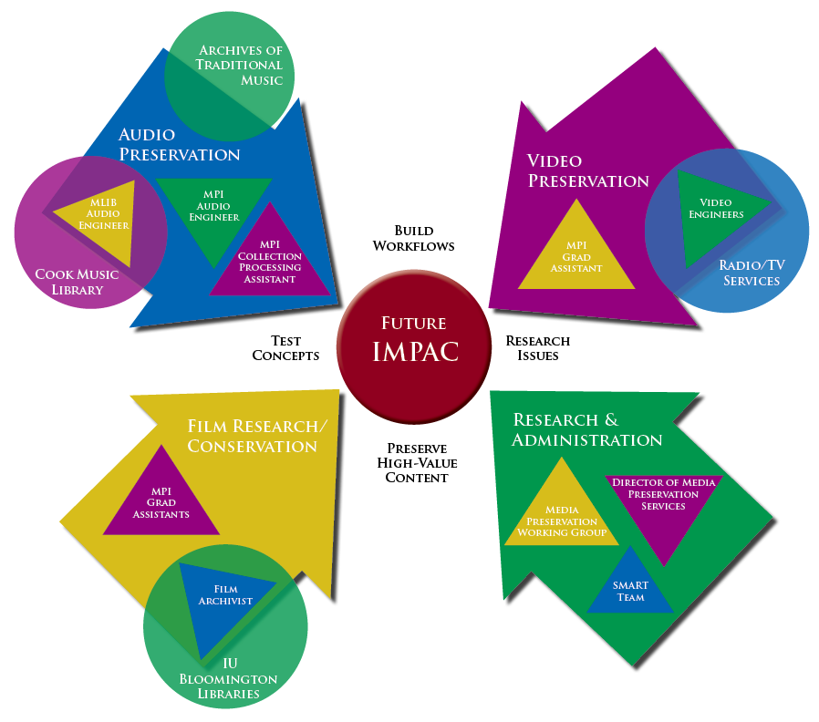

Slide 34
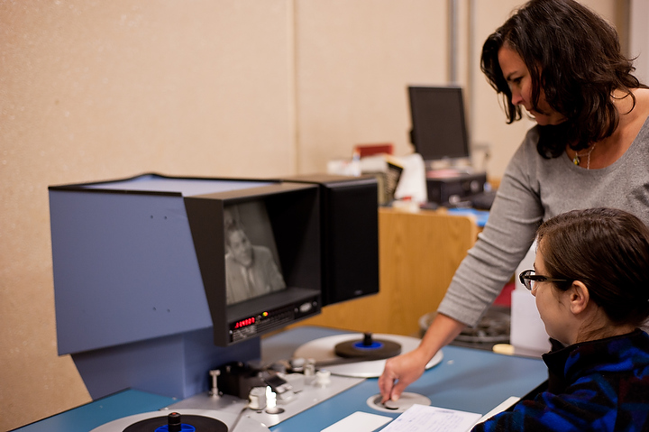

Slide 35
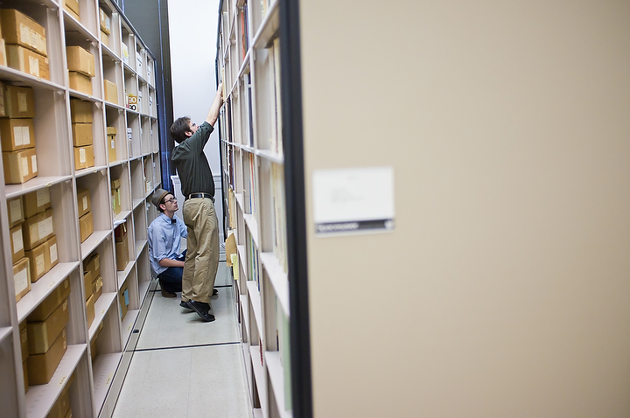

Slide 36
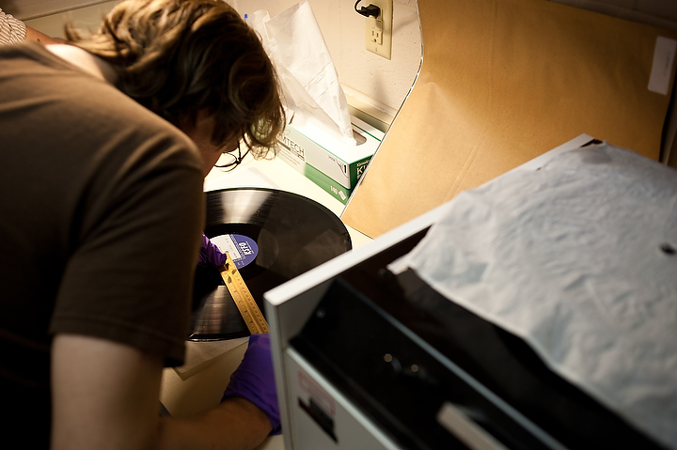

Slide 37
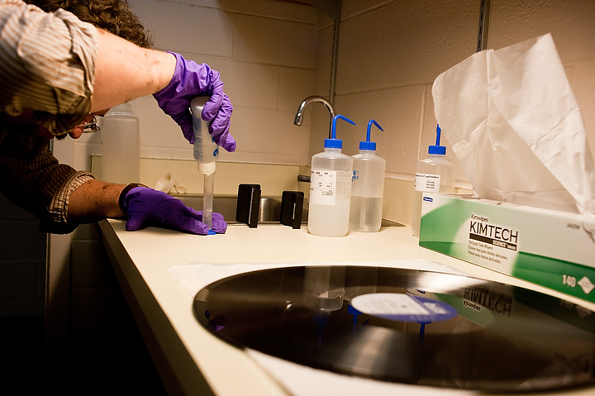

Slide 38
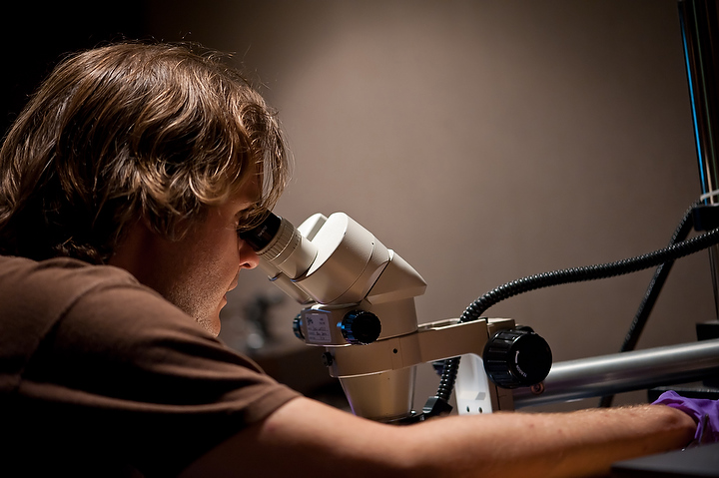

Slide 39
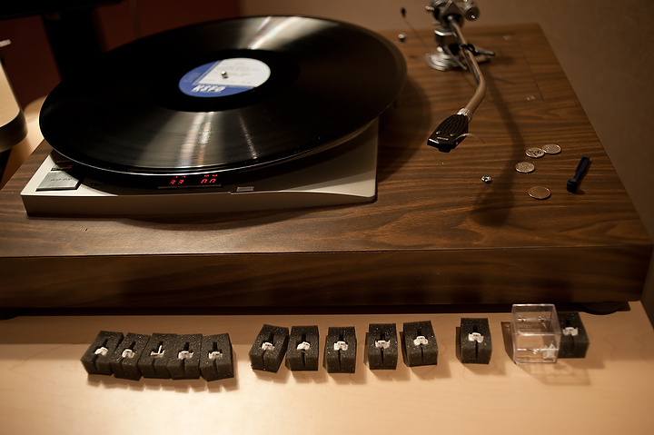


Slide 40




Communications Strategy
indiana.edu/~medpres/
MediaPreservation.wordpress.com
/MediaPreservation
@MediaPresIUB
Notes:
Media Preservation Initiative Presentation World Day for Audio Visual Heritage Oct 27, 2011

Slide 41
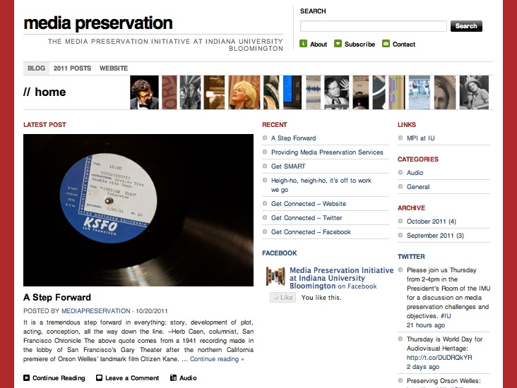
Blog: mediapreservation.wordpress.com

Slide 42
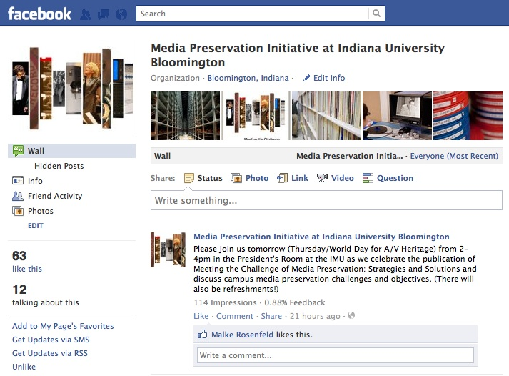
Facebook: facebook.com/MediaPreservation

Slide 43
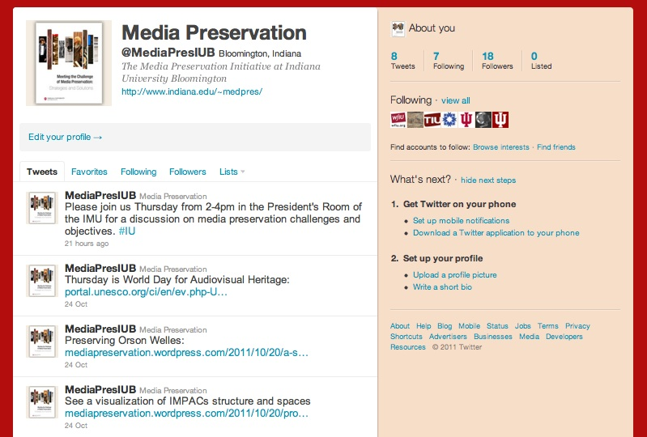
Twitter: twitter.com/MediaPresIUB

Slide 44
Related Initiatives
Variations on Video
IMLS grant
Lead: IU Libraries / Digital Library Program
Development Partner: Northwestern University Library
Partners/participants: Stanford, UVA, NYU, UConn, Miami, Harvard, York (UK), Rock Hall, WGBH/Boston, Opencast/UC Berkeley, Hydra Project
October 2011 – September 2014

Slide 45
Related Initiatives
Variations on Video
Develop open source online access system for audio and video collections
Support copyright, licensing, and ethical restrictions
Discovery through standards-based metadata
Delivery to desktop and mobile platforms

Slide 46
Strategies
Media Preservation Targets 2013-2027
15 year time frame
207,000 hours of audio (82% of total IUB holdings) = 284,000 recordings
83,000 hours of video (53% of total holdings) = 66,000 recordings
27,000 hours of film (69% of total holdings)

Slide 47
Indiana University Bloomington
Media Preservation Initiative
Mike Casey
Director of Media Preservation Services
micasey@indiana.edu
Website: http://www.indiana.edu/~medpres/
Blog: http://mediapreservation.wordpress.com/

